Slide 1
Face Recognition based Attendance System

Slide 2
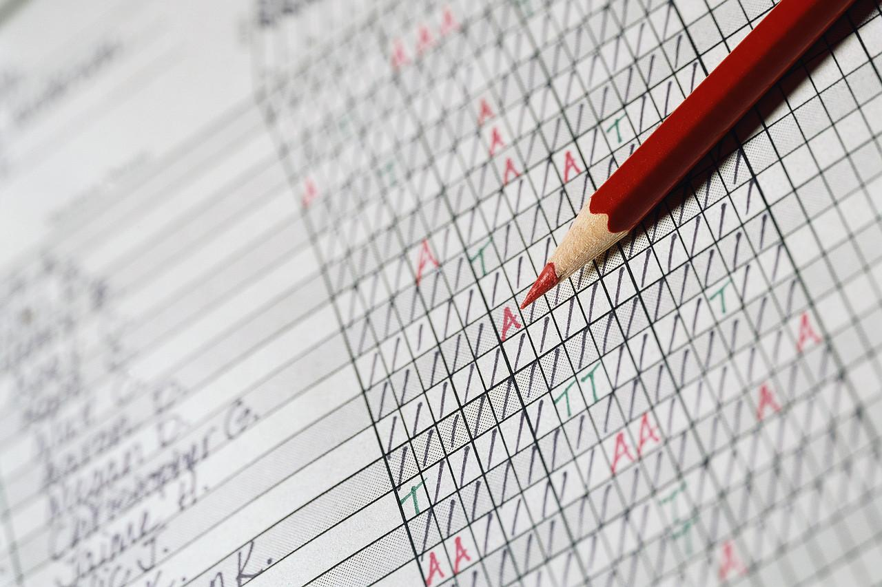
The problem
5-10 mins is wasted for taking attendance.
Statistical data is hard to compute and analyze.
False attendance and proxy.

Slide 3

Best possible solutions
Scanning ID cards
Use finger print
Use Face Recognition

Slide 4
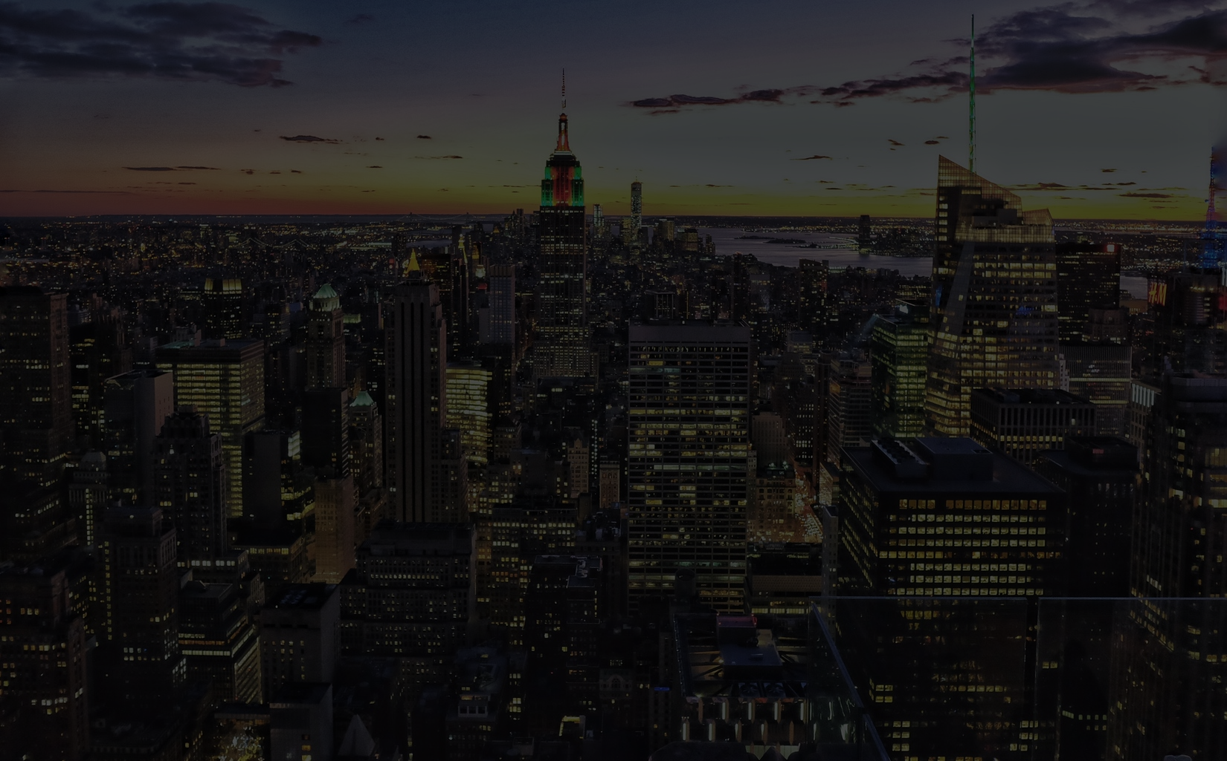
Problem with RFID Scanner :
Costly
False Attendance
Waiting time large

Slide 5
Problem with Fingerprint :
Fingerprint template takes a lot of space(240kB)
Costly
Waiting time is large

Slide 6
Face Recognition

Slide 7
Disadvantages :
Facial constraint
Processing is slow

Slide 8
Advantages :
Affordable
One - time investment
Easy to use

Slide 9
How it works
Step 3
Step 2
Step 1
Recognize faces and modify the attendance in the excel sheet
Detect and crop the faces in an input image
Create and train the dataset(one time only)

Slide 10
Technologies used :
dlib library
Microsoft Cognitive Face API
Openpyxl
sqlite3
Implemented on Python2.7

Slide 11
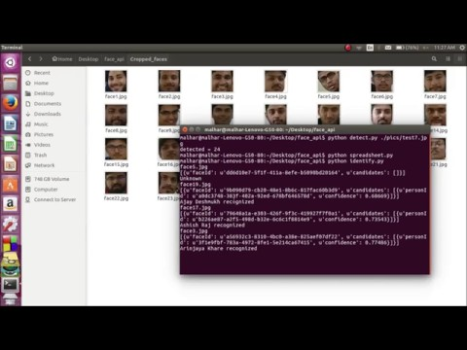
Video

Slide 12
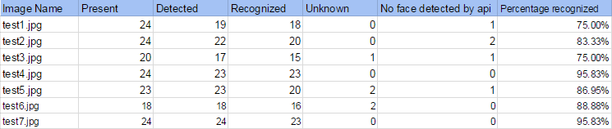
Results
No false recognition i.e., either the face recognized was correct or unknown
We tested it on a class filled with 24 students at different parts of the classroom(both densely and sparsely populated) and it marks the attendance of all of them

Slide 13
Future Improvement :
Auto Alert for teachers and students
Automation of Camera
Special optimization for students sitting at the back of the class

Slide 14

Cost Comparison
RFID scanner(Rs. 3000+)
Finger Print Scanner(Rs. 2000+)

Slide 15
Cost for this product :
Under Rs. 1,000

Slide 16
Technical specification :
Camera at least 10MP
Internet
And just a computer...

Slide 17
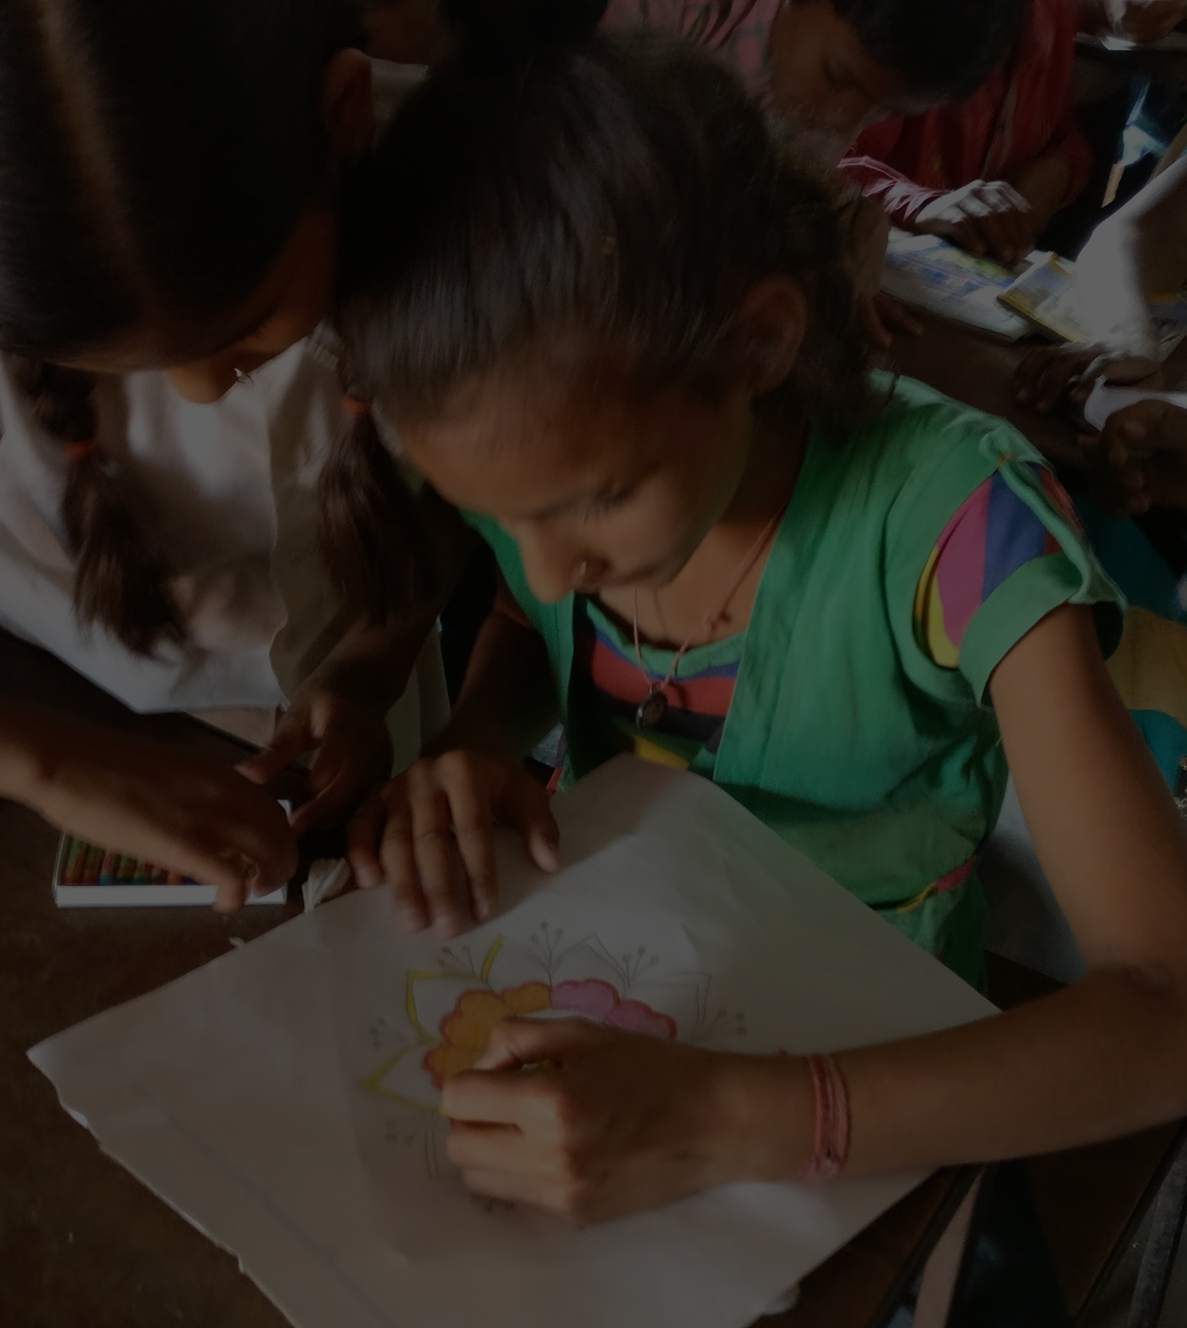
Boon for educational system
Action against “Flying Schools” can be taken, hence enhancing education
Easy to record and analyze the statistics without any manipulation

Slide 18
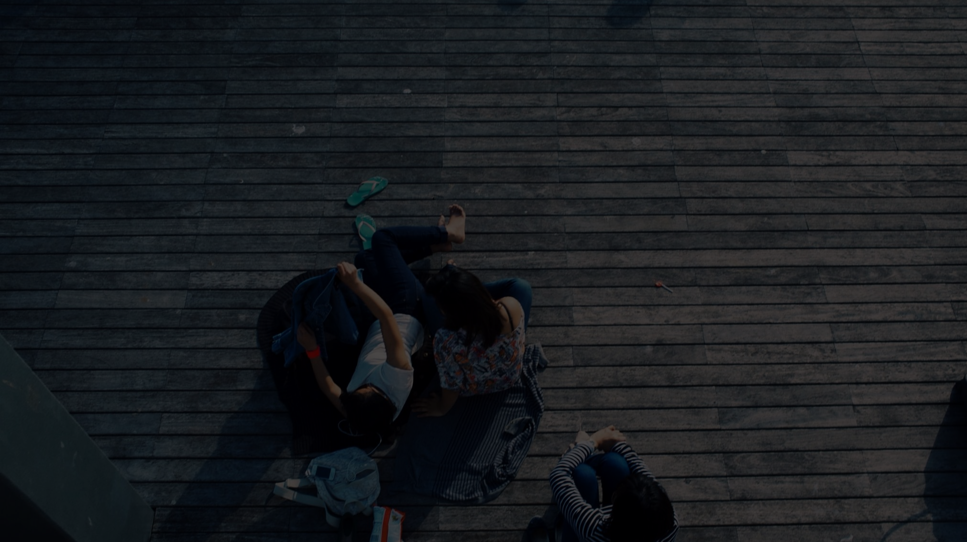
References :
OpenCV Documentation - http://docs.opencv.org/2.4/modules/contrib/doc/facerec/facerec_tutorial.html
Dlib Documentation - http://dlib.net/imaging.html
Microsoft Face API - https://www.microsoft.com/cognitive-services/en-us/face-api
Openpyxl - https://openpyxl.readthedocs.io/en/default/

Slide 19
Thank You

